Slide 1







(HT) Obtaining Raw Materials
Read Now
Monday, 26 January 2026
(HT) Obtaining Raw Materials
Task:
Complete the Read Now by:
Stick in the sheet.
Using a highlighter as you read to identify key terms.
Answer the first four recall questions under the sheet in your book.
Answer the stretch question
(HT) Obtaining Raw Materials
(HT) Obtaining Raw Materials
Aim High | Work Together | Be Kind | Lead the Way

Slide 2

Read Now
Aim High | Work Together | Be Kind | Lead the Way
Aim High | Work Together | Be Kind | Lead the Way

Slide 3
Read Now
MARK SCHEME
B
biodiversity
Noise pollution / air pollution / water pollution (any one)
It leaves large holes/spoil heaps and makes the area look unattractive.
WHAT: Habitats are destroyed when land is dug up and plants are removed. WHY: Fewer habitats means fewer organisms can survive, so the number of species falls.
Aim High | Work Together | Be Kind | Lead the Way
Aim High | Work Together | Be Kind | Lead the Way

Slide 4
Daily Review
Follow your teachers instructions:
“When I say go show me a MWB and a MWB Pen”
You will have 10 seconds for each question.
Hold your MWB in the Ready position
“Show me”
You need to score 70% to pass
Subtitle ‘test score’ ?/10
Aim High | Work Together | Be Kind | Lead the Way
Notes:
Teachers remember to input the quiz score

Slide 5
MWB Quiz
What is the name of an organism that eats other organisms?
What is used to increase the yield of a farmer’s field?
What is the term for an extreme food shortage?
What is the term for having enough food to feed a population?
What is the process of minerals moving through the soil due to rain fall?

Slide 6
MWB Quiz
What is the name of an organism that eats other organisms? Predator
What is used to increase the yield of a farmer’s field? Fertiliser
What is the term for an extreme food shortage? Famine
What is the term for having enough food to feed a population? Food security
What is the process of minerals moving through the soil due to rain fall? Leaching

Slide 7
Objectives
List some disadvantages of mining and quarrying
Define bioleaching and phytomining
Explain how bioleaching and phytomining are carried out
Lesson 1
Lesson 2
Lesson 3
Lesson 4
Lesson 5
Lesson 6
Lesson 8
Lesson 9
Lesson 10
Lesson 7
Aim High | Work Together | Be Kind | Lead the Way
Notes:
11.2 5.19

Slide 8

Extracting Copper
Copper prices have increased rapidly since 2003.
Why might this be?
Copper-rich ores are becoming more scarce.
Notes:
Copper prices have increased rapidly since 2003. Why do you think this is? Copper-rich ores are becoming more scarce.
We have mined copper ores for many years to extract the copper from them. Copper ores are non-renewable.
We use a huge amount of copper worldwide , mostly for electrical equipment such as wiring and motors.

Slide 9
Extracting Copper
Copper ores vary in the percentage of copper they contain.
If they contain very little copper, extracting it might be more costly than it is worth!
As the availability of high-grade copper ores dwindles, scientists are looking for more effective ways to use low-grade copper ores to obtain copper.
There are two main methods currently being used:
Bioleaching
Phytomining
Notes:
Model teacher exposition:
Some copper ores contain a high percentage of copper, and some some copper ores contain less copper.
In 1950, the ores we used to get copper had 90% copper! By 2010, we were using ores that contain just 30% copper.
If ores contain a small percentage of copper it can be extremely expensive to extract (and sometimes not worth it). We call copper ores with a low percentage of copper ‘low-grade copper ores’.
Because high-grade copper ores are becoming more scarce, scientists have had to find some effective ways to extract copper from low grade ores. The two methods we will learn about today are bioleaching and phytomining.
Using these methods means that we don’t need to mine for ores or to create large quarries. Obtaining raw materials from the Earth by quarrying and mining causes environmental impacts, such as contamination of nearby water sources, noise pollution, habitat loss, deforestation, and the quarries look unattractive.

Slide 10
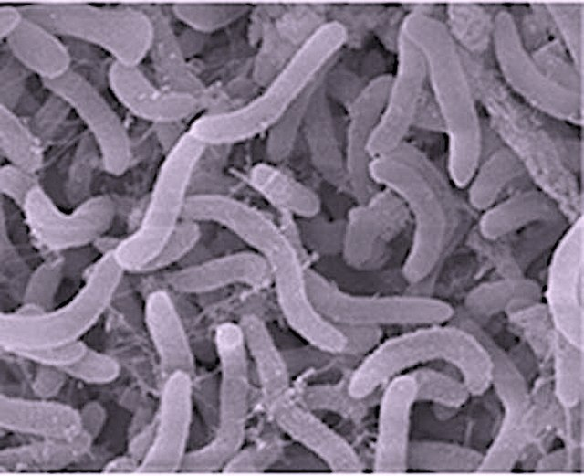
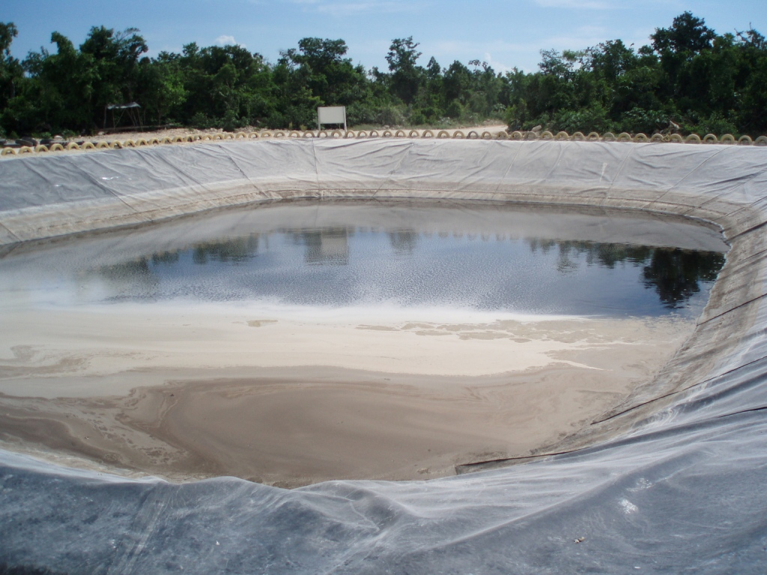
Bioleaching
This method produces around 20-25% of all copper extracted from ores.
However, there is a long way to go with bioleaching… Scientists are looking for ways to speed up this process which can take years!
Bioleaching is a method to extract metals from their ore using living organisms such as bacteria.
Bacteria are added to low-grade ores.
2. They ‘feed’ on the ore, creating a solution of ions called leachate.
3. The copper solutions are then purified using displacement reactions or electrolysis.
Notes:
A video can be used to support students’ understanding of bioleaching e.g. https://www.youtube.com/watch?v=aSb5PNwrRx0
Model teacher exposition:
Bioleaching is a method to extract metals from their ore using living organisms such as bacteria.
What about the word ‘bioleaching’ gives us a clue as to its meaning? ‘Bio’ means living thing
For bioleaching to occur
First, bacteria are added to low-grade ores
Then, these bacteria feed on that ore and create a solution of ions called a leachate. The image here shows a large pool of leachate.
Finally, this solution containing copper ions is processed to extract the copper. This can be done by a displacement reaction or by electrolysis. For example, copper can be obtained from solutions of copper compounds by displacement using scrap iron or by electrolysis.
This method currently produces 20-25% of all copper tht e currently extract from ores. However, scientists have a long way to go to make this a fast process. Currently, it can take years!

Slide 11




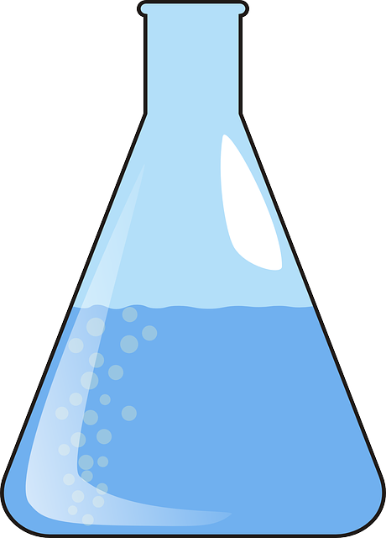
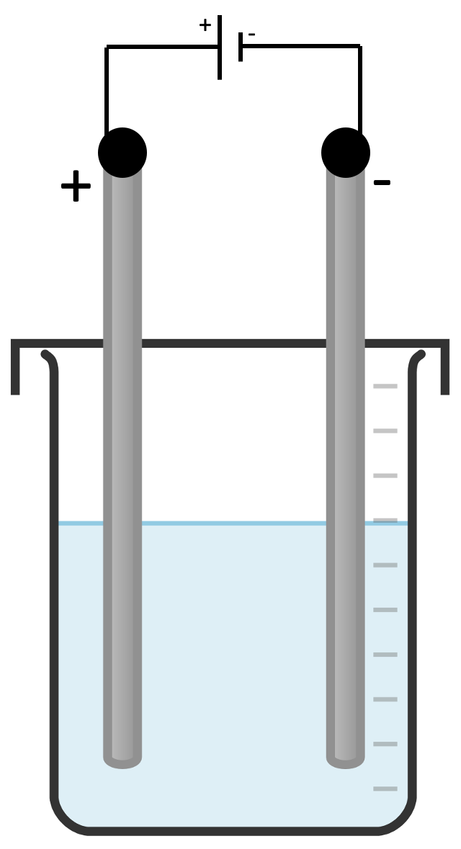
Phytomining
Phytomining is a method to extract copper metal from low-grade copper ore in soil, using plants
1.
2.
3.
4.
5.
Notes:
These diagrams are provided on a separate document that can be printed to support students to make notes on the steps of phytomining.
Model teacher exposition:
The second method of extracting metal from a low-grade ore is phytomining. Phytomining is used to extract copper metal from the low grade ore in soil, using plants.
Hand out the phytomining storyboard.
I am going to go through each step, to tell you about phytomining. I would like you to listen carefully, and annotate (write) into the storyboard sheet to record the most important information for each stage. You may use labels, written text, or drawings to add this information to your storyboard.
Step 1: Soil contains low grade copper ore. Plants absorb the metal ions from the soil, using their roots, and store them.
Step 2: The plants are burned in oxygen. This produces waste carbon dioxide gas (CO₂).
Step 3:The oxygen gas reacts with the copper ions in the plant, to make copper oxide (CuO). This looks like black ash. Copper oxide is an ore of copper.
Step 4: This copper oxide is added to sulphuric acid to form copper sulphate solution (a blue liquid). CuO + H₂SO₄ → CuSO₄ + H₂O
Step 5: Electrolysis is used to extract pure copper from the copper sulphate solution. The copper ions are discharged at the cathode (negative electrode).

Slide 12
Bioleaching → bacteria
Phytomining → plants
Notes:
in mining, humans and machines do the work.
In bioleaching and phytomining, we let living organisms do the work for us.

Slide 13

Is this statement correct?
Bioleaching is a method to extract copper metal from low-grade copper ore in soil, using plants
Notes:
Answer: it is incorrect because bioleaching uses bacteria and not plants.

Slide 14
Drill
State a use of copper metal.
Are copper ores renewable or non-renewable?
What word is given to a copper ore containing a low percentage of copper?
State one disadvantage of mining copper ores.
List two methods that can be used to effectively extract copper from low-grade copper ores.
Define bioleaching.
Define phytomining.
When bacteria feed on are ore, what do we call the solution of metal ions that they produce?
What process is used to extract pure copper metal from a copper sulphate solution?
At which electrode will copper metal form in electrolysis?
Notes:
Purpose: This is a knowledge drill. The purpose of this is to check that the critical knowledge is secure before pupils move onto independent practice.
Suggested guidance: There are a range of ways this could be done depending on time and ability range of the class:
Mini whiteboards
As full sentences in exercise books
As short answers in exercise books
In the pupil workbook
As pair talk
As cold call

Slide 15
Drill answers
Copper metal is used for electrical wiring.
Copper ores are non-renewable.
Low-grade copper ores
One disadvantage of mining copper ores is that it can result in habitat destruction.
Phytomining and bioleaching
Bioleaching is a method to extract metals from their ore using living organisms such as bacteria.
Phytomining is a method to extract copper metal from low-grade copper ore in soil, using plants
When bacteria feed on an ore, they produce a solution called leachate
Electrolysis is used to extract copper from a copper sulphate solution
Copper metal will form at the cathode (negative electrode)
Notes:
Purpose: This is a knowledge drill. The purpose of this is to check that the critical knowledge is secure before pupils move onto independent practice.
Suggested guidance: There are a range of ways this could be done depending on time and ability range of the class:
Mini whiteboards
As full sentences in exercise books
As short answers in exercise books
In the pupil workbook
As pair talk
As cold call

Slide 16

I: Describe: to recall facts, events or processes in an accurate way
Example question:
To ‘describe’, your answer should:
Use bullet points to keep your answer clear
Cover enough points to fully answer the question
Use scientific keywords in your answer
‘Say what you see’ if there is a diagram, graph or table.
Phytomining is used to obtain copper from land that contains very low percentages of copper compounds.
Describe how copper compounds are obtained by phytomining.
Model answer:
grow plants on land containing copper ores
burn the plants to form ash (copper oxide)
dissolve the copper oxide in (sulfuric) acid to form copper sulfate (leachate) solution
carry out the electrolysis of this solution to form pure copper
Notes:
This slide models the process of answering a describe question.
Firstly, students are presented with a generic describe question, along with a model answer. Students are also given some simple guidance to follow for producing their own describe answer.
The generic question and answer should be used by the teacher to remind students of
the key features of a great answer
how to structure their answer
why the model answer is a good example
Following this, students will be required to apply this process to answer their own describe question, which will appear in place of the generic questions. This describe question will be specific to the topic students are learning about in the lesson. Give students time to write their own answer to this, ensuring that they use the guidance provided. To further scaffold this task for students, it may be appropriate to:
pair students up to write an answer together
list for students the key words you would like them to include in the answer
provide a writing frame or ‘points to include’ for students
A model answer for this question will appear. Teachers should review the model answer with students by referencing the guidance in the green box. For example ‘we can see item 1 in the guidance is to use bullet points to keep your answer clear. Notice in the model answer here we have done just that’. Or ‘item 2 in the guidance here says that we should use scientific keywords in the answer. Has this been achieved in the model answer? Where can we see this?’.

Slide 17
We: Describe: to recall facts, events or processes in an accurate way
Example question:
To ‘describe’, your answer should:
Use bullet points to keep your answer clear
Cover enough points to fully answer the question
Use scientific keywords in your answer
‘Say what you see’ if there is a diagram, graph or table.
Soil near copper mines is often contaminated with low percentages of copper compounds.
Phytomining is a new way to extract copper compounds from soil.
Describe how copper compounds are extracted by phytomining.
Model answer:
grow plants on land containing copper ores
burn the plants to form ash (copper oxide)
dissolve the copper oxide in (sulfuric) acid to form copper sulfate (leachate) solution
carry out the electrolysis of this solution to form pure copper
Notes:
This slide models the process of answering a describe question.
Firstly, students are presented with a generic describe question, along with a model answer. Students are also given some simple guidance to follow for producing their own describe answer.
The generic question and answer should be used by the teacher to remind students of
the key features of a great answer
how to structure their answer
why the model answer is a good example
Following this, students will be required to apply this process to answer their own describe question, which will appear in place of the generic questions. This describe question will be specific to the topic students are learning about in the lesson. Give students time to write their own answer to this, ensuring that they use the guidance provided. To further scaffold this task for students, it may be appropriate to:
pair students up to write an answer together
list for students the key words you would like them to include in the answer
provide a writing frame or ‘points to include’ for students
A model answer for this question will appear. Teachers should review the model answer with students by referencing the guidance in the green box. For example ‘we can see item 1 in the guidance is to use bullet points to keep your answer clear. Notice in the model answer here we have done just that’. Or ‘item 2 in the guidance here says that we should use scientific keywords in the answer. Has this been achieved in the model answer? Where can we see this?’.

Slide 18
You: Describe: to recall facts, events or processes in an accurate way
Example question:
To ‘describe’, your answer should:
Use bullet points to keep your answer clear
Cover enough points to fully answer the question
Use scientific keywords in your answer
‘Say what you see’ if there is a diagram, graph or table.
Phytomining is used to obtain copper from land that contains very low percentages of copper compounds.
Describe how copper compounds are extracted by phytomining.
Model answer:
grow plants on land containing copper ores
burn the plants to form ash (copper oxide)
dissolve the copper oxide in (sulfuric) acid to form copper sulfate (leachate) solution
carry out the electrolysis of this solution to form pure copper
Notes:
This slide models the process of answering a describe question.
Firstly, students are presented with a generic describe question, along with a model answer. Students are also given some simple guidance to follow for producing their own describe answer.
The generic question and answer should be used by the teacher to remind students of
the key features of a great answer
how to structure their answer
why the model answer is a good example
Following this, students will be required to apply this process to answer their own describe question, which will appear in place of the generic questions. This describe question will be specific to the topic students are learning about in the lesson. Give students time to write their own answer to this, ensuring that they use the guidance provided. To further scaffold this task for students, it may be appropriate to:
pair students up to write an answer together
list for students the key words you would like them to include in the answer
provide a writing frame or ‘points to include’ for students
A model answer for this question will appear. Teachers should review the model answer with students by referencing the guidance in the green box. For example ‘we can see item 1 in the guidance is to use bullet points to keep your answer clear. Notice in the model answer here we have done just that’. Or ‘item 2 in the guidance here says that we should use scientific keywords in the answer. Has this been achieved in the model answer? Where can we see this?’.

Slide 19
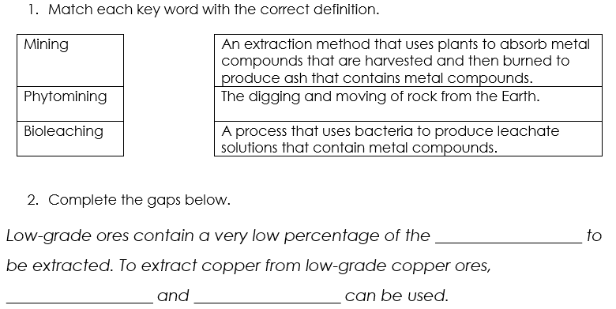
Answers – Section A
metal
phytomining
bioleaching

Slide 20
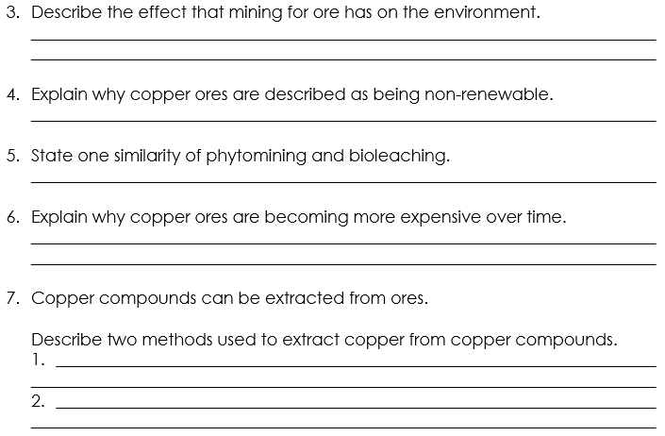
Answers – Section A
Destroys habitats
Fixed amount on Earth and doesn’t replenish
Both use organisms. Both used to obtain copper ore from low-grade ore
Copper ore is becoming more scarce.
Methods used to extract copper ore are costly.
Reduction with carbon.
Electrolysis of copper compounds in solution.

Slide 21
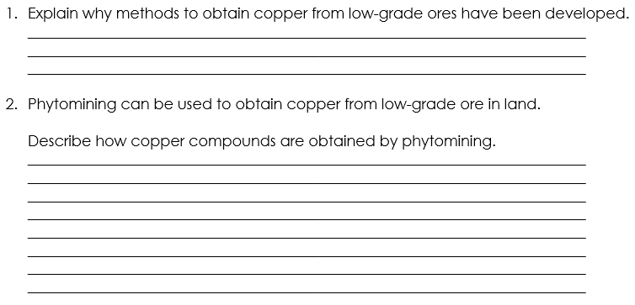
Answers – Section B
Copper is a non-renewable resources and is becoming more scarce. We need copper to make electrical wiring so methods have been developed for extraction from the remaining low-grade ores.
Plants absorb metal ions from soil containing low-grade copper ore and store them.
The plants are burned in oxygen to produce copper oxide and carbon dioxide.
The copper oxide is added to sulfuric acid to form copper sulfate solution which is then electrolysed to obtain pure copper.
Notes:
Step 1: Soil contains low grade copper ore. Plants absorb the metal ions from the soil, using their roots, and store them.
Step 2: The plants are burned in oxygen. This produces waste carbon dioxide gas (CO₂).
Step 3:The oxygen gas reacts with the copper ions in the plant, to make copper oxide (CuO). This looks like black ash. Copper oxide is an ore of copper.
Step 4: This copper oxide is added to sulphuric acid to form copper sulphate solution (a blue liquid). CuO + H₂SO₄ → CuSO₄ + H₂O
Step 5: Electrolysis is used to extract pure copper from the copper sulphate solution. The copper ions are discharged at the cathode (negative electrode).

Slide 22
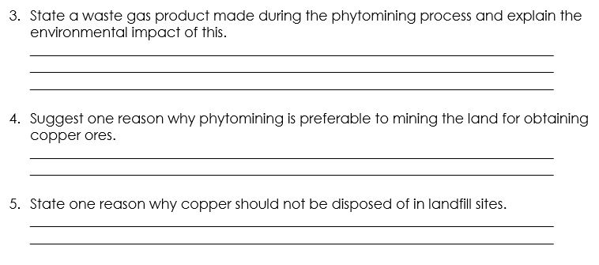
Answers – Section B
Carbon dioxide is the waste gas produced which has an environmental impact because carbon dioxide is a greenhouse gas contributing to global warming.
Reduces the need for mining of rock which destroys habitats.
Copper ore is running out so should be recycled/reused.
Landfill sites are filling up.
Copper compounds are toxic to organisms

Slide 23
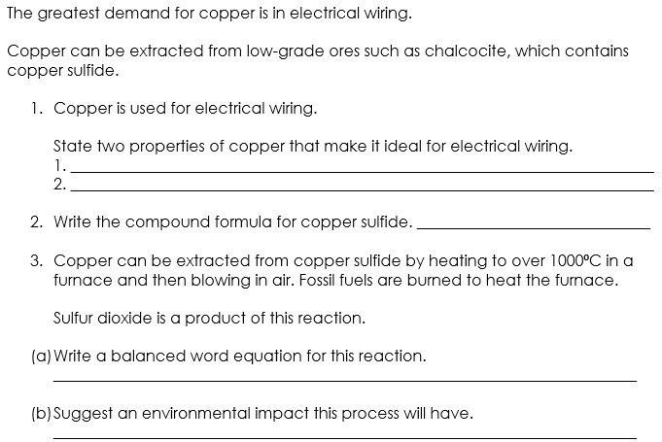
Answers – Section C
Good electrical conductor
Ductile
CuS
CuS + O₂ → Cu + SO₂
SO₂ pollutes the atmosphere.
Using fossil fuels produces CO₂ which is a greenhouse gas.

Slide 24
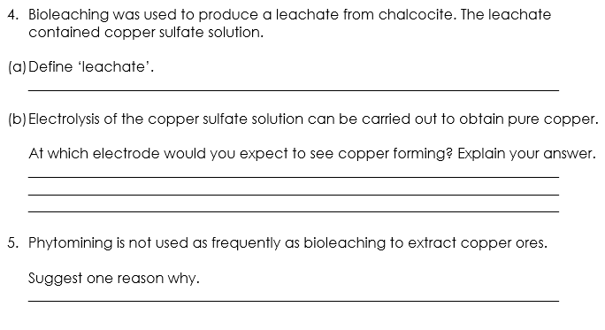
Answers – Section C
A solution of ions produced by bacteria in bioleaching.
At the negative electrode (cathode) because copper ions are positively charged so move towards the negative electrode.
Land may not be available.
Takes a long time for plants to grow.

Slide 25

Deliberate Practice
Aim High | Work Together | Be Kind | Lead the Way

Slide 26
I: Describe: to recall facts, events or processes in an accurate way
Deliberate Practice
Phytomining is used to obtain copper from land that contains very low percentages of copper compounds.
Describe how copper compounds are obtained by phytomining.
Model answer:
grow plants on land containing copper ores
burn the plants to form ash (copper oxide)
dissolve the copper oxide in (sulfuric) acid to form copper sulfate (leachate) solution
carry out the electrolysis of this solution to form pure copper
Aim High | Work Together | Be Kind | Lead the Way

Slide 27
We: Describe: to recall facts, events or processes in an accurate way
Deliberate Practice
Soil near copper mines is often contaminated with low percentages of copper compounds.
Phytomining is a new way to extract copper compounds from soil.
Describe how copper compounds are extracted by phytomining.

Slide 28
You: Describe: to recall facts, events or processes in an accurate way
Deliberate Practice
Phytomining is used to obtain copper from land that contains very low percentages of copper compounds.
Describe how copper compounds are extracted by phytomining.

Slide 29
Check for Understanding
Which organism is used in bioleaching?
Plants
Animals
Bacteria
Fungi
✅ Answer: 3

Slide 30
Check for Understanding
Which method uses plants to extract metals?
Mining
Quarrying
Bioleaching
Phytomining
✅ Answer: 4

Slide 31
Check for Understanding
What is a leachate?
Solid ore
Melted rock
A solution of metal ions
Pure copper metal

Slide 32
Check for Understanding
The rocks melt during bioleaching.
True / False

Slide 33
Check for Understanding
The rocks melt during bioleaching.
True / False

Slide 34
Check for Understanding
What is phytomining?
Extracting metals using bacteria
Extracting metals using plants
Extracting metals by melting rock
Extracting metals by electrolysis
✅ Answer: 2

Slide 35
Check for Understanding
Where do the plants get the metal from in phytomining?
The air
The leaves
The soil
The water only
✅ Answer: 3

Slide 36
Check for Understanding
What happens to the plants after they have absorbed metal compounds?
They are eaten
They are frozen
They are harvested and burned
They are left to rot

Slide 37
Check for Understanding
Why is phytomining considered more environmentally friendly than mining?
It is faster
It uses high temperatures
It causes less habitat destruction
It produces more waste

Slide 38
Answer the questions below.
State the name of the process where plants are used to extract metals from compounds.
A. Phytomining
B. Bioleaching
C. Mining
✓
2. Copper is now extracted from ores containing a low percentage of copper compounds. Why is this?
A. Other methods are too expensive
B. Copper ores are becoming scarce
C. So that electrolysis can be carried out
✓
3. Why is phytomining preferable to traditional mining of copper ores?
A. It results in less destruction of habitats
B. It is faster
C. It is more expensive
✓
Notes:
Q1. Answer: A
If students answer B or C, they are unable to define the methods of extracting metals from ores. To fix-it, ask students to review their notes and then to define each term.
Q2. Answer: B
If students answer A or C, they do not understand why alternative methods of extraction are needed. To fix-it, show students the graphs on slides 8 and 9 of this powerpoint and ask them to explain what they tell us.
Q3. Answer: A
If students answer B or C, they are unable to describe a disadvantage of traditional mining. To fix-it, ask students to create a table that compares traditional mining with phytomining, including any environmental effects.

